Slide 1
The Well-being Multi-Instrument Comparison study

Slide 2
Project background
Several well-being questionnaires have been developed to use in non-curative care to evaluate technology and services
These questionnaires are at different stages of development and have never been compared altogether in the same context/population
It is still unclear which instruments should be used to assess the effectiveness of an intervention targeting well-being in a specific context
This question led to the project named “The Well-being Multi-Instrument Comparison” (W-MIC) study

Slide 3
W-MIC research questions
How do wellbeing scores vary across different health conditions and demographic subgroups?
What are the conceptual similarities and differences across the instruments?
Are the instruments able to distinguish individuals with different severity levels across clinical conditions?
Do the instruments provide reliable measurement of wellbeing over time?
How responsive are the well-being instruments to changes in health or well-being over time?

Slide 4
W-MIC study design
Part 1 involves an online survey with participants from the general population and with specific disease conditions
Part 2 focuses on three case studies in non-curative care aimed at improving WB in people with dementia or in the elderly

Slide 5







Collaborating partners

Slide 6
Online survey sample
Sample size of 7,000 respondents from the Netherlands and the US:
General population
Elderly population (>70 years old)
Diabetes
Arthritis
Depression
Sleep-related disorders
Heart-related disorders
List of disorders are under discussion
A 25% subgroup will complete a follow-up measurement

Slide 7
Online survey design
The survey content will consist of five main modules (presented from A-E)
Within modules A, C and D, the order of the questionnaires will be randomized
Module A
Well-being measures
EQ-HWB
SWB-5D
Module B
Clinical measures
Disease-specific questionnaires
Module C
Generic well-being
EQ-5D
WOOP
WiX
ASCOT
QOL-ACC
Module D
General Health
Hedonic
Eudaimonic
Affective
Self-rated health
Module E Demographics
E.g., age, gender, education, relationship, employment, income, carers, living situation
ICECAP (A for adults, O for older respondents)
Notes:
The survey will consist of five main modules, covering the main well-being measures, clinical measures for the various disease groups, generic well-being and health questions and some demographics data.
They will presented in this order to present questions that are more cognitively demanding as well as most relevant for our research questions at first.
Within each module, the order of the questionnaires will be randomized
Discuss with Dynata to provide information regarding drop-out rate
Guide respondents to the different modules (e.g., Module A: Well-being measures)
The questions that select participants should come first in the survey
Questions that are not too important or require low cognitive abilities can be put at the end

Slide 8
Online survey design
The survey content will consist of five main modules (presented from A-E)
Within modules A, C and D, the order of the questionnaires will be randomized
Module A
Demographics (Part 1)
ASCOT-STC4
Module C
Clinical measures
Disease-specific questionnaires (PHQ-9, RAPID-3, PROMIS Sleep disturbance 8A, DLQI, MacNew)
Module D
Generic well-being
EQ-5D-5L
WOOP
Module D
General Health
SWLS (hedonic)
SPANE (affective)
Self-rated health and health satisfaction
Module E Demographics
Education, relationship, employment, income, and living situation
EQ-HWB
ICECAP-A
ICECAP-O
WiX
QOL-ACC
SWB-5D
Module B
Well-being measures
Age, gender, social care status
OECD questions (eudaimonic)
Notes:
The survey will consist of five main modules, covering the main well-being measures, clinical measures for the various disease groups, generic well-being and health questions and some demographics data.
They will presented in this order to present questions that are more cognitively demanding as well as most relevant for our research questions at first.
Within each module, the order of the questionnaires will be randomized
Discuss with Dynata to provide information regarding drop-out rate
Guide respondents to the different modules (e.g., Module A: Well-being measures)
The questions that select participants should come first in the survey
Questions that are not too important or require low cognitive abilities can be put at the end

Slide 9
Online survey routing
Population | Demographics | Well-being measures |  |  |  |  | Generic health |  | Generic well-being |  |  | Subgroup-specific |  |  | Disease-specific |  |  |  |  | Total items
 |  | EQ-HWB | WiX | SWB-5D | ASCOT | ICECAP-A | EQ-5D | Self-rated health | SWLS | OECD questions | SPANE | WOOP | QOL-ACC | ICECAP-O | PHQ-9 | RAPID-3 | Short PSQI | TBD | TBD
General | 8 | 9 | 10 | 5 | 9 | 5 | 6 | 2 | 5 | 6 | 4 | - | - | - | - | - | - | - | - | 69
Older people |  |  |  |  |  |  |  |  |  |  |  | 9 | 6 | 5 | - | - | - | - | - | 89
Depression |  |  |  |  |  |  |  |  |  |  |  | - | - | - | 9 | - | - | - | - | 78
Arthritis |  |  |  |  |  |  |  |  |  |  |  | - | - | - | - | 12 | - | - | - | 81
Sleep |  |  |  |  |  |  |  |  |  |  |  | - | - | - | - | - | 13 | - | - | 82
Diabetes |  |  |  |  |  |  |  |  |  |  |  | - | - | - | - | - | - | TBD | - | TBD
Heart |  |  |  |  |  |  |  |  |  |  |  | - | - | - | - | - | - | - | TBD | TBD
Inclusion of ASCOT / QOL-ACC is under discussion
Considering the inclusion of a general symptom checklist
Notes:
This is an overview of our survey and what respondents will answer to.
All of them will answer our main well-being measures, which cover various conceptualization of well-being (from subjective well-being as in the EQ-HWB, WiX and SWB-5D, to capability well-being, such as in ICECAP, and social care quality of life, as in the ASCOT and QOL-ACC).
The older people subgroup will answer well-being measures that target older populations, such as the WOOP and ICECAP-O. While all other disease groups will answer disease-specific questionnaires, which we will look into more details in a minute.
They will also answer questions that cover different aspects of generic well-being, including hedonic well-being through the SWLS, eudaimonic through OECD questions and affective well-being through a selection of SPANE items.

Slide 10
Conceptual Coverage
Instrument | Mental health | Physical health | Cognitive health | Relationships | Support | Living environment | Safety | Finance | Relaxation and leisure | Activities | Acceptance and resilience | Independence | Self-worth | Personal hygiene | Life enjoyment / satisfaction | Quality of care | Thinking of future | Sleep issues
EQ-HWB | x | x | x | x |  |  |  |  |  | x |  | x
WiX | x | x |  | x | ~ | x | x | x | x | x | ~ | x | x
WOOP | x | x | ~ | x | x | x |  | x |  | ~ | x | x | x
SWB-5D | x | ~ |  | x |  |  |  |  |  | ~ | ~ | x
ASCOT |  |  |  | x |  | x | x |  | ~ | x |  | x | x | x |  | ~
QOL-ACC | x | x |  | x |  |  |  |  | x |  |  | x
ICECAP-A |  |  |  | x | x |  | x |  |  |  |  | x | ~ |  | x
EQ-5D | x | x |  |  |  |  |  |  |  | x |  |  |  | x
ICECAP-O |  |  |  | x |  |  |  |  | x | ~ |  | x | x |  |  |  | x
PHQ-9 | x | x | x |  |  |  |  |  |  |  |  |  |  |  |  |  |  | x
RAPID-3 |  | x |  |  |  |  |  |  |  | x |  |  |  | x
Short PSQI | x | x |  |  |  |  |  |  |  | x |  |  |  |  |  |  |  | x
SWLS |  |  |  |  |  |  |  |  |  |  |  |  |  |  | x
OECD | x |  |  |  |  |  |  |  |  |  |  | x | x |  | x
SPANE | x
x indicates full coverage
~ indicates partial coverage
Notes:
This slides provide an overview of the conceptual coverage across all instruments (well-being measures, disease-specific measures and generic health and well-being questionnaires).
As it can be seen, the survey will cover a wide range of aspects, with particular attention to mental health and physical health as well as other broader aspects of well-being such as their relationship, activities and independence.
Other less commonly covered aspects will also be investigated, such as their feelings of personal safety and finance satisfaction.
The x indicates full coverage, meaning that the items in the questionnaire directly enquire about that specific aspect. The cells in yellow indicate partial coverage, meaning that they do not fully address that aspect or only touches upon it broadly.
An example is an item from the SWB-5D which asks about whether their health restricts their physical activities. This is not directly asking about their physical health nor about their ability to engage in all types of activities (but rather only physical ones), therefore this is why it was categorized as partial coverage.

Slide 11
Case studies overview
Short-stay, emergency clinic for people with dementia, aimed at de-escalation and regaining control
Motion sensors to promote physical activity in patients undergoing rehabilitation for hip fractures
Tessa Tinybots to increase independence through verbal guidance in clients living in long-term care facilities
Case study 1
Case study 2
Case study 3

Slide 12
Case study design
Population: A total of 170 participants will be recruited across the three case studies
Design: Clients will complete well-being measures at least at enrollment and at discharge with the help of a Dutch interviewer
Caregivers/family members can respond on behalf of the client or together

Slide 13
Information on Psychometric Assessment
For the seven well-being measures, we will look at the following psychometric properties:
Ceiling / Floor effects
Test-retest reliability
Structural validity
Convergent and discriminate validity
Known-group validity
Responsiveness
Additional analyses may be explored based on other interests/research ideas

Slide 14
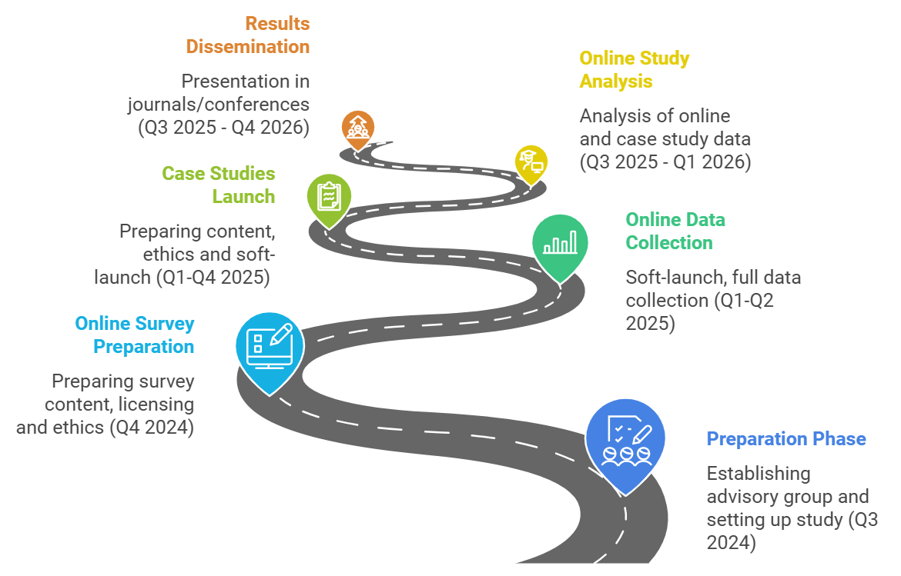
Project timeline

